Slide 1
How to Debug a Website
David Catuhe
Edge / Open web standards
@deltakosh – davca@microsoft.com

Slide 2
Why some web sites are not working with Edge

Slide 3
Top reasons
User agent sniffing
Unsupported webkit CSS prefixes
Binary plugins required (ActiveX, Silverlight)

Slide 4
Compatibility Scanner
Modern.ie has a compatibility scanner
Lists out potential issues that cause web sites not to work in IE11 or Edge
Suggests modern web standards to fix issues
https://www.modern.ie/en-us/report

Slide 5
Changing User Agent String

Slide 6
User agent strings
Changing User Agent String
User agent strings can be modified by changing the document mode in the F12 developer tools
Default for IE11 is Mozilla/5.0 (Windows NT 6.3; Trident/7.0; rv:11.0) like Gecko
This is to prevent sniffing for the MSIE token, which many developers use to send non-standard code to (based on previous IE versions)

Slide 7
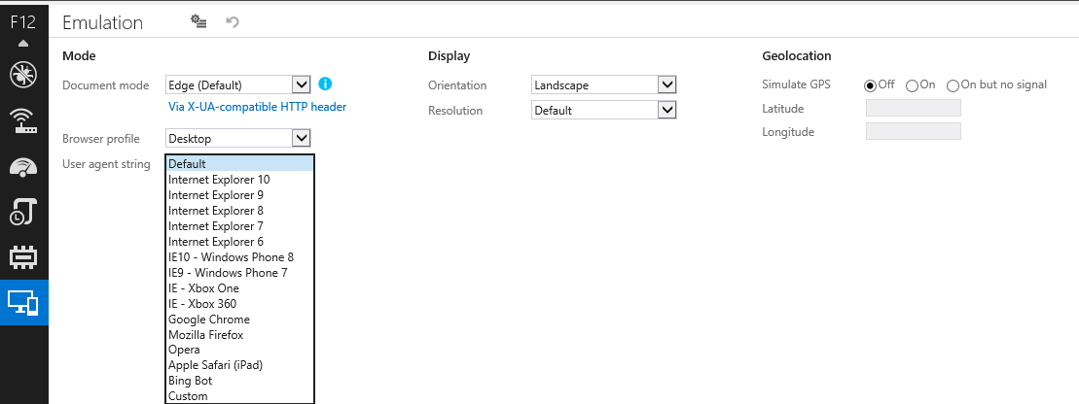
Modifying user agent strings
Changing User Agent String
Using F12 developer tools, the user agent string can be changed by clicking on the Emulation tab on the left-hand side

Slide 8
Using modern.ie scanner

Slide 9
Overview
Using modern.ie scanner
https://modern.ie/en-us/report
"Scan for common coding problems"
Lets you enter a URL and quickly view report

Slide 10
Compatibility mode
Using modern.ie scanner
This one only apply to IE11
Tells you if your site is running in compatibility mode
Your site should be rendering in standards mode to improve performance in IE9 & IE10
To ensure standards mode rendering, you can add this meta tag in the <head> of your page:
<meta http-equiv="X-UA-Compatible" content="IE=Edge">
Additionally, ensure you're using the HTML doctype:
<!DOCTYPE html>

Slide 11
Frameworks & libraries
Using modern.ie scanner
Checks to ensure the frameworks and libraries you're using support the latest versions of Internet Explorer
Frameworks and libraries include:
jQuery
Modernzir
Bootstrap
Underscore
Backbone
RequireJS
Angular
and many more

Slide 12
Web standards docmode
Using modern.ie scanner
This one only apply to IE11
Essentially just checks your doctype
Will get "errors" if not using the HTML5 doctype
<!DOCTYPE html>
Using the HTML5 doctype also helps ensure your site renders in Standards mode

Slide 13
CSS Prefixes
Check to make sure css prefixes are being used correctly
Allows you to view the selectors that are missing vendor prefixes
Missing css vendor prefixes mean your site could render incorrectly
Ensures vendor prefixes are being used for certain css properties
Full list of checks comes from http://peter.sh/experiments/vendor-prefixed-css-property-overview/
Helps ensure CSS works in IE11 and other modern browsers including devices like iPads, iPhones, Kindles, etc

Slide 14
CSS Prefixes Example
a {
transition: color ease 0.3s;
}

Slide 15
CSS Prefixes Example
a {
-moz-transition: color ease 0.3s;
-o-transition: color ease 0.3s;
-webkit-transition: color ease 0.3s;
transition: color ease 0.3s;
}

Slide 16
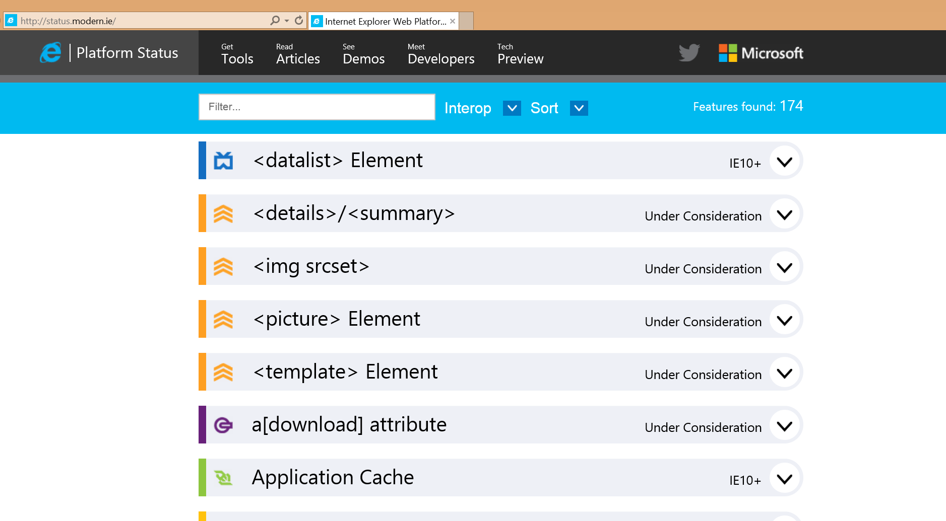
status.modern.ie
Using modern.ie scanner
Your ultimate site to check if a feature is supported

Slide 17
Browser plug-ins
Using modern.ie scanner
Checks to see if your page is using plug-ins
Plug-ins include:
Adobe Flash
ActiveX
Plug-ins aren't supported on devices like the iPad, Microsoft Surface, Amazon Kindle, etc. so it's important to keep your site plug-in free

Slide 18
Responsive web design
Using modern.ie scanner
Detects if your site is using media queries for responsive breakpoints

Slide 19
Browser detection
Using modern.ie scanner
Detects places where you might be using browser detection techniques
Common uses of browser detection are to target older versions of Internet Explorer
Placing an HTML5 shiv or IE specific styles inside conditional comments is okay, but just make sure you're targeting ONLY the versions necessary

Slide 20
Optimize the images on your page
Using modern.ie scanner
Detects how optimized your bitmap images are
Make sure you're optimizing images before using them on the web
Applications like Photoshop make this easy by "saving for web"
Other command line tools are available to use with task runners like Grunt and Gulp
https://www.npmjs.org/package/gulp-image-optimization
https://github.com/gruntjs/grunt-contrib-imagemin

Slide 21
HTML5 inputs
Using modern.ie scanner
Detects uses of HTML5 inputs
It is good practice to take advantage of HTML5 inputs, as they degrade gracefully so fallbacks are typically not needed
Example of HTML5 inputs are:
color
date
email
month
email
number

Slide 22
Prerender + prefetch
Using modern.ie scanner
Checks for techniques that load content in advance to make for a faster browsing experience
Preload specifies a page to be loaded in the background while the user reads the current page
Prefetch identifies resources to be downloaded in the background
Can use link tags to prerender and prefetch
<link rel="prerender" href="http://example.com/nextpage.html" />
<link rel="prefetch" href="http://example.com/style.css" />

Slide 23
Compressed content
Using modern.ie scanner
Checks to see if your server is sending compressed content

Slide 24
Touch-first browsing
Using modern.ie scanner
Detects for enhancements made for touch-based browsing
Core techniques for good touch browsing include:
Avoid showing content on mouse hover (touch devices don't have hover states)
Use appropriately sized buttons and CTA elements
More advanced uses of touch involve using gestures or panning and zooming behaviors

Slide 25
Debugging using F12 tools

Slide 26
DOM Explorer
The first tab in the tools is the DOM explorer
Allows you to inspect the current state of the DOM
Can choose an element and modify it’s attributes, and css styles
Turn on highlighting to see where each element falls in the DOM
Can also access by right clicking an element and choosing “Inspect Element”
Notes:
The dom explorer is very useful for finding out what’s happening at the current moment rather than just “view source”

Slide 27
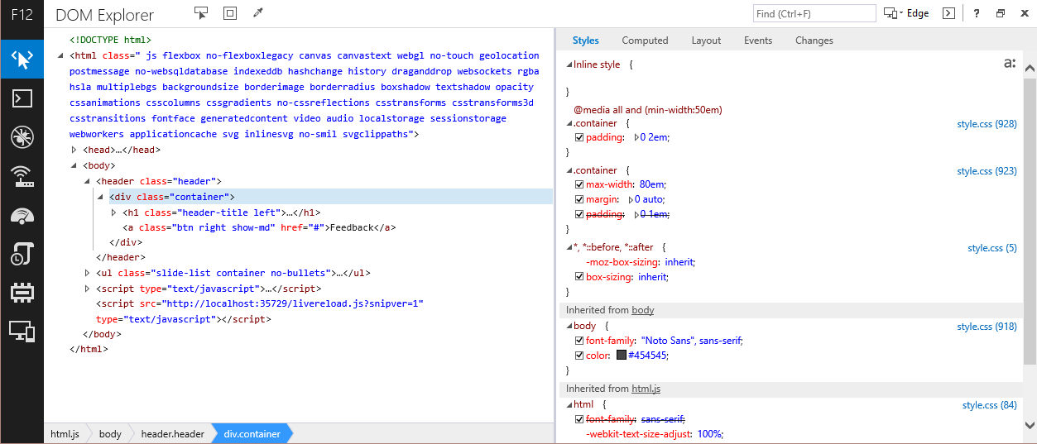
DOM Explorer
Notes:
Click an element to view it’s css properties.
You can see the current styles in the styles tab
You can see the entire DOM tree on the left

Slide 28
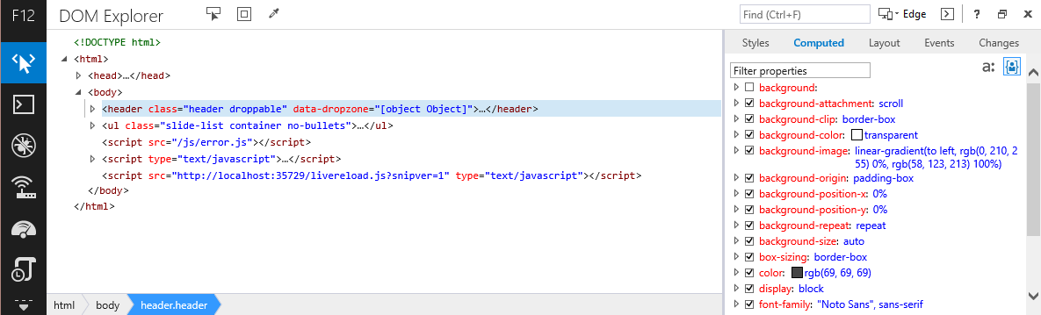
DOM Explorer
Notes:
Here you can see the computed styles for this element.

Slide 29
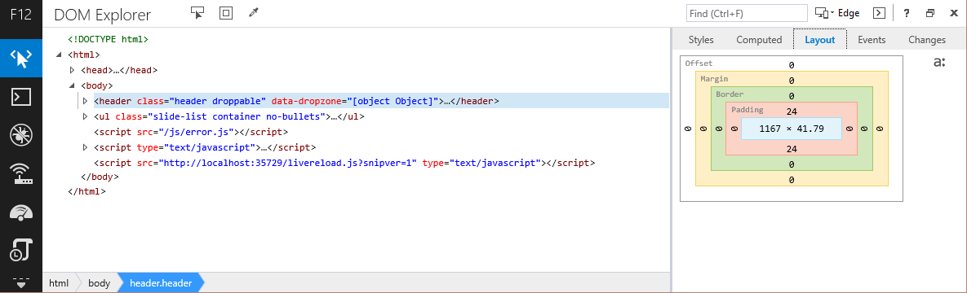
DOM Explorer
Notes:
Here you can see the computed styles for this element.

Slide 30
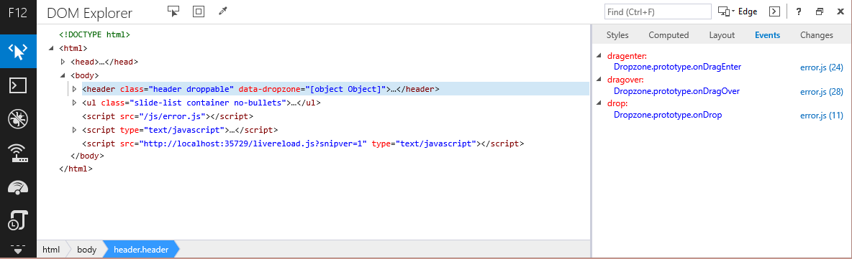
DOM Explorer
Notes:
Here are any dom events on the element and their location in the JavaScript code

Slide 31
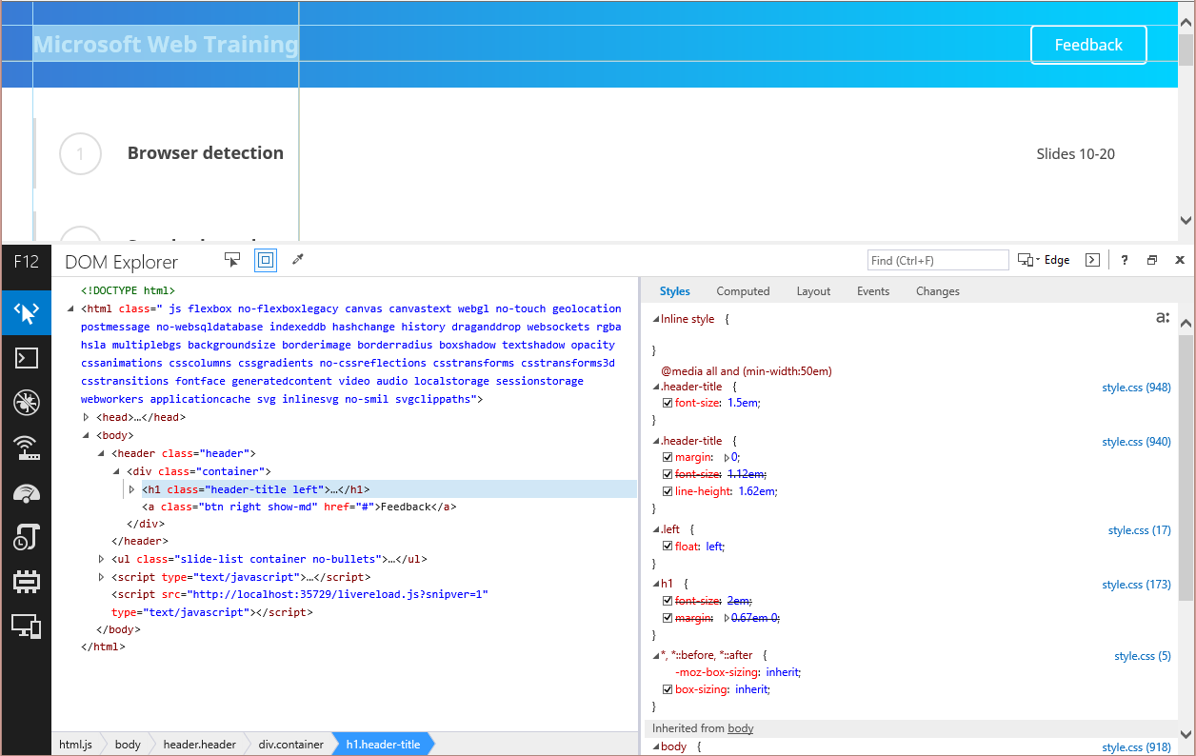
DOM Explorer
Notes:
Here you can see element highlighting is active

Slide 32
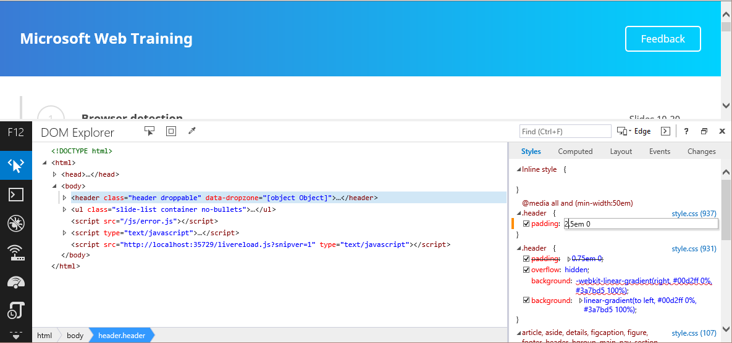
DOM Explorer
Notes:
Can edit the styles of an element.
Changes show up in the changes tab.

Slide 33
Debugger
Dropdown contains all JavaScript on the page
Can add breakpoints to pause execution at that point
Can go step by step through the code
Pause on exceptions
Prettify minified code for debugging in production if needed
Call stack for seeing code execution path
Add watchers for current value of a variable
Use in tandem with console for great debugging experience

Slide 34
Debugger Example
Drag and drop example
Can drag text or images into a dropzone
If it’s a file drop, show the number of files
If it’s an element, show its tag
Notes:
Let’s have a look at an example of a bug in some code and how the debugger can help find the issue

Slide 35
Debugger Example
There’s a bug in this code! It always shows the file number even if an element was dragged
Dropzone.prototype.onDrop = function (event) {
var files = event.dataTransfer.files;
if (files) {
console.log("you dropped: " + files.length + " files.");
}
else {
console.log("you dropped: " + event.dataTransfer.getData("text"));
}
event.preventDefault();
};
Notes:
Here’s some sample code
mswebtraining.azurewebsites.net

Slide 36
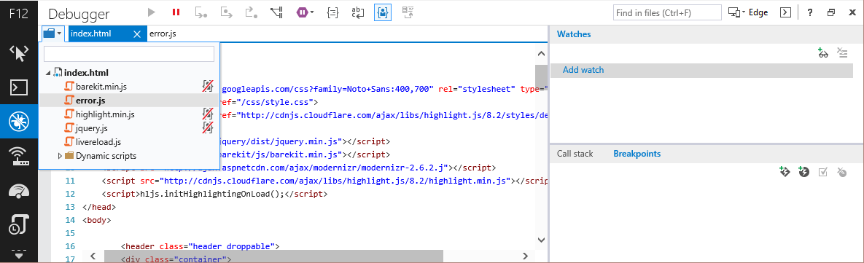
Debugger Example
Select a file using the dropdown and filter
Notes:
This allows you to pick a file, and you can type in the box to find a specific file.
The red cross tells you which files are yours versus 3rd party libraries

Slide 37
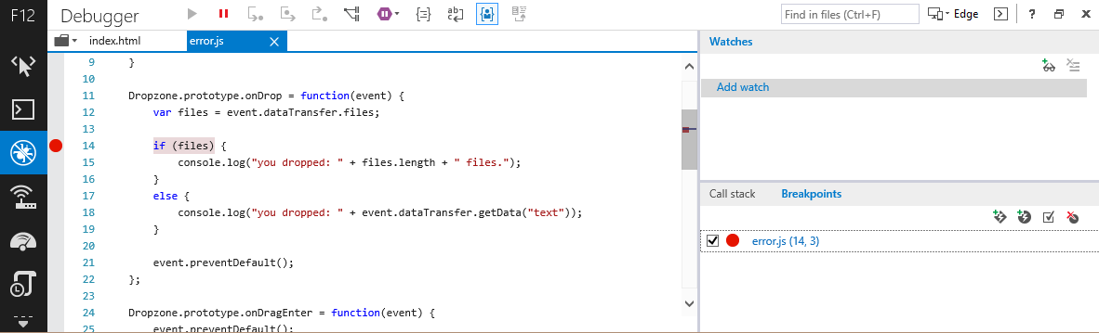
Debugger Example
With the F12 Tools debugger, you can add a breakpoint to see what’s happening
Notes:
Click in the left gutter to add a breakpoint.
Also, the purple pause button tells the tools to break on exception
The curly brace icon is what allows you to prettify code

Slide 38
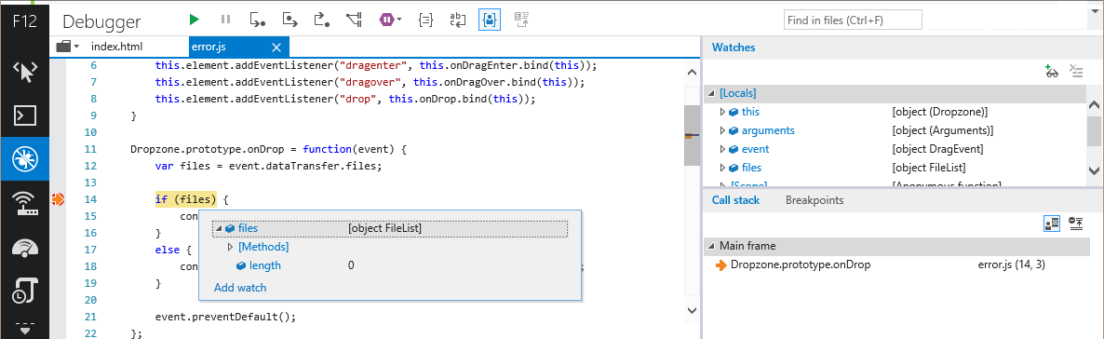
Debugger Example
Notice how the fileList is an object
This will make it pass the if statement no matter the length of the files
Hover over files, or notice locals in the Watches panel
Notes:
Here we’re hovering over files in the code, but you’ll notice you can also see the files in the right hand panel

Slide 39
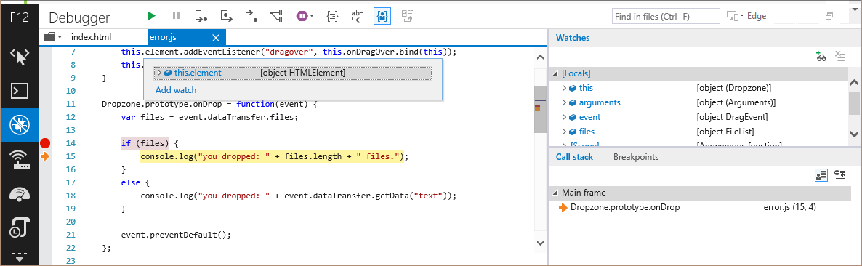
Debugger Example
Press “Step Over” or F10 to step into the if statement
Call stack shows current function execution
Notes:
There are also buttons and commands for stepping into a function, and out of a functio

Slide 40
Network
Inspect incoming traffic
Look at headers, JSON and XML data
Helpful debugging Ajax requests
Helpful to find large files that could be compressed

Slide 41
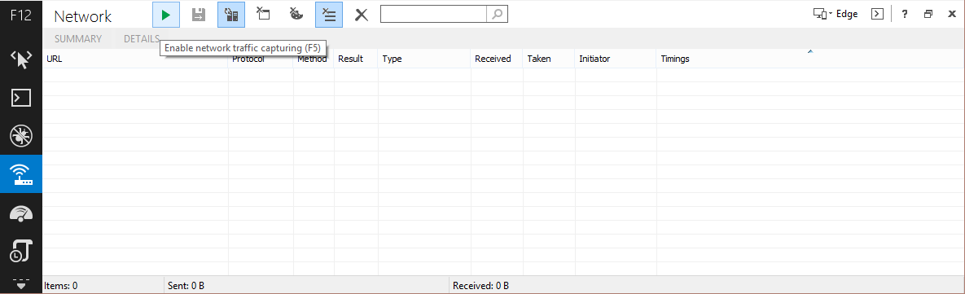
Network
Enable traffic monitoring, then refresh

Slide 42
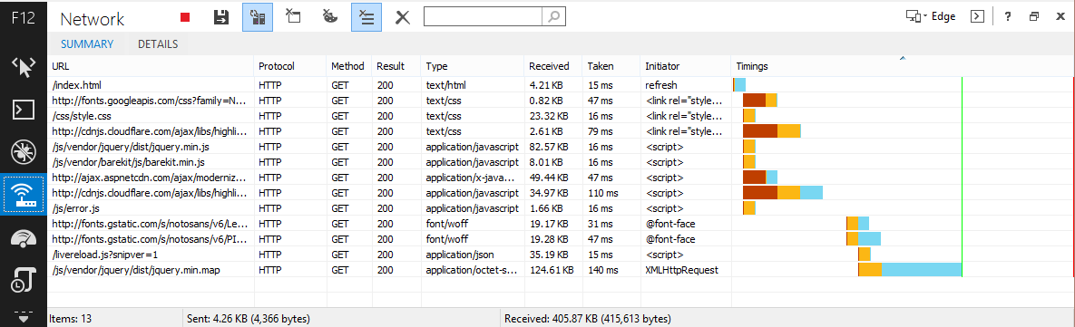
Network
Shows HTTP method and result
Type, size, and time to download, as well as what requested the download

Slide 43
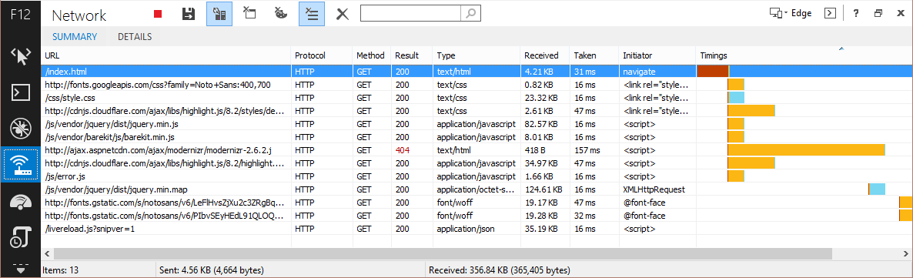
Network
Find server errors such as 400, 404, and 500
Here you can see modernizr.js was misspelled in the code to just .j

Slide 44
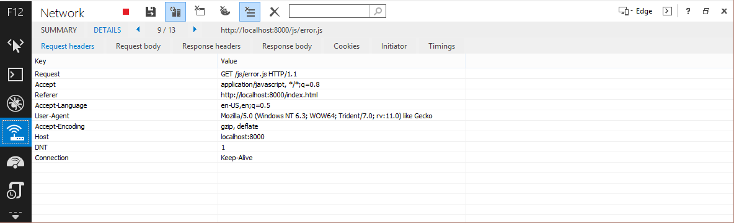
Network
Get all the details about a specific request

Slide 45
Questions?

